Slide 1
Flappy bird – rešeno sa Q learning-om
Danilo Nikolić 617/2018
Ivan Radivojević 619/2019

Slide 2
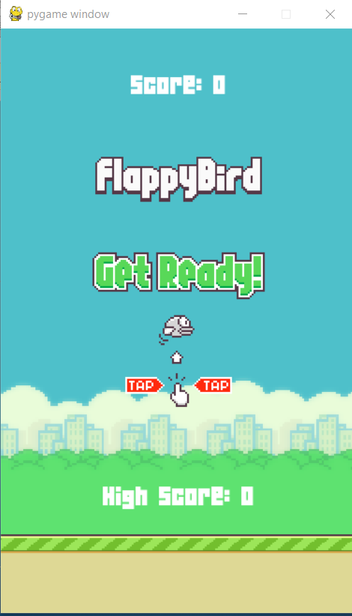
Igrica

Slide 3
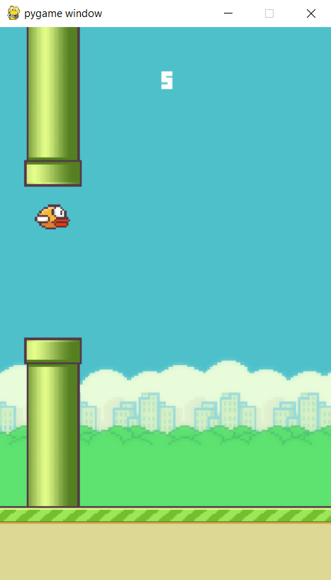
igrica

Slide 4
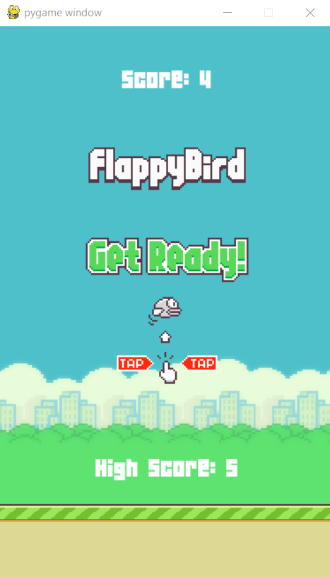
Igrica

Slide 5
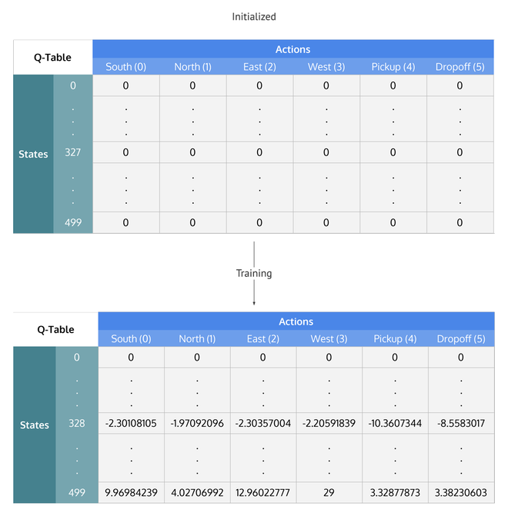
Q LEARNING

Slide 6
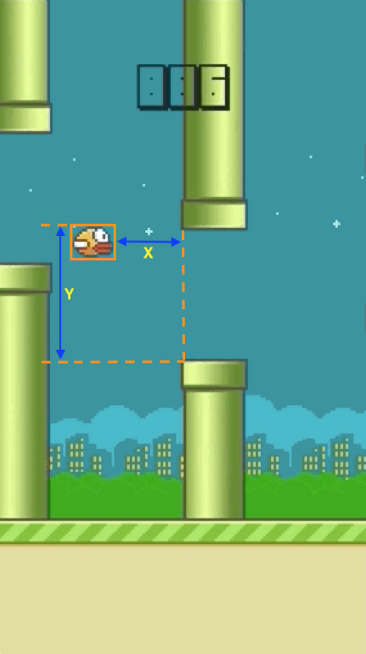
Q LEARNING

Slide 7
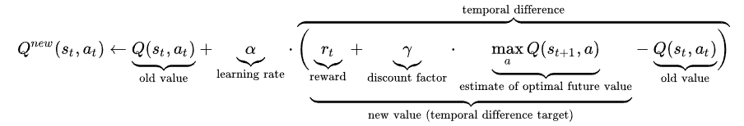
Q LEARNING

Slide 8
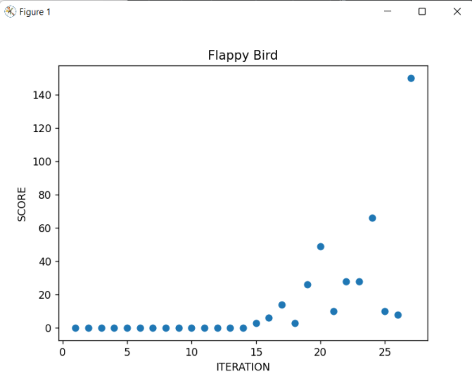
Q LEARNING

Slide 9
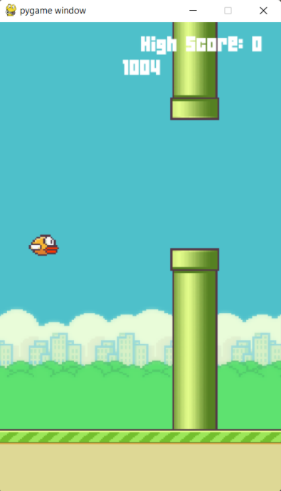
Q LEARNING

Slide 10
Hvala na pažnji!

